Slide 1
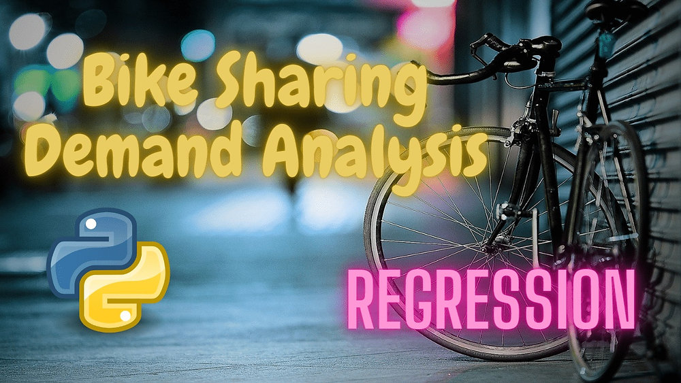
Bike Sharing Demand Prediction

Slide 2
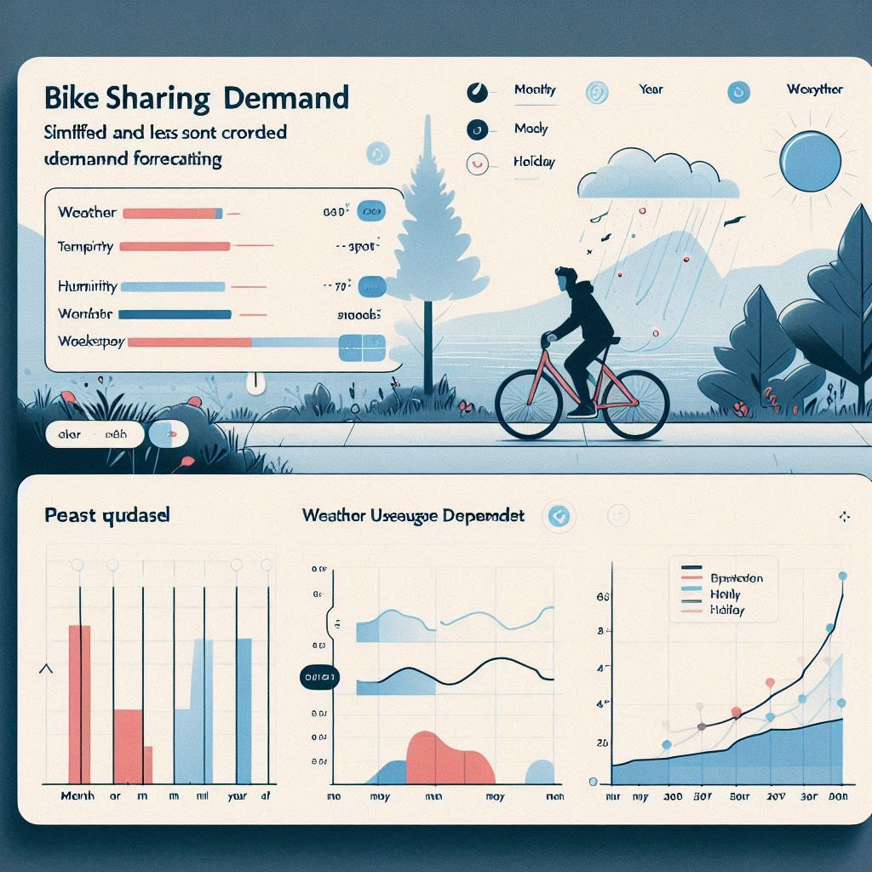
Introduction to Bike Sharing Demand Prediction
Bike sharing systems are becoming increasingly popular in urban areas to promote sustainable transportation.
Machine learning offers powerful tools for accurate demand forecasting based on various data features.
Aim is to develop a new Machine learning model to predict bike-sharing demand based on various factors such as weather….
Notes:
Image source: https://images.singletracks.com

Slide 3
Step 1 - Importing Necessary Libraries
Importing libraries like pandas and numpy facilitates data manipulation and numerical computations.
Visualization libraries such as matplotlib and seaborn are essential for exploratory data analysis.
Machine learning libraries like scikit-learn provide models and tools for building predictive algorithms.
Notes:
Image source: https://images.singletracks.com

Slide 4
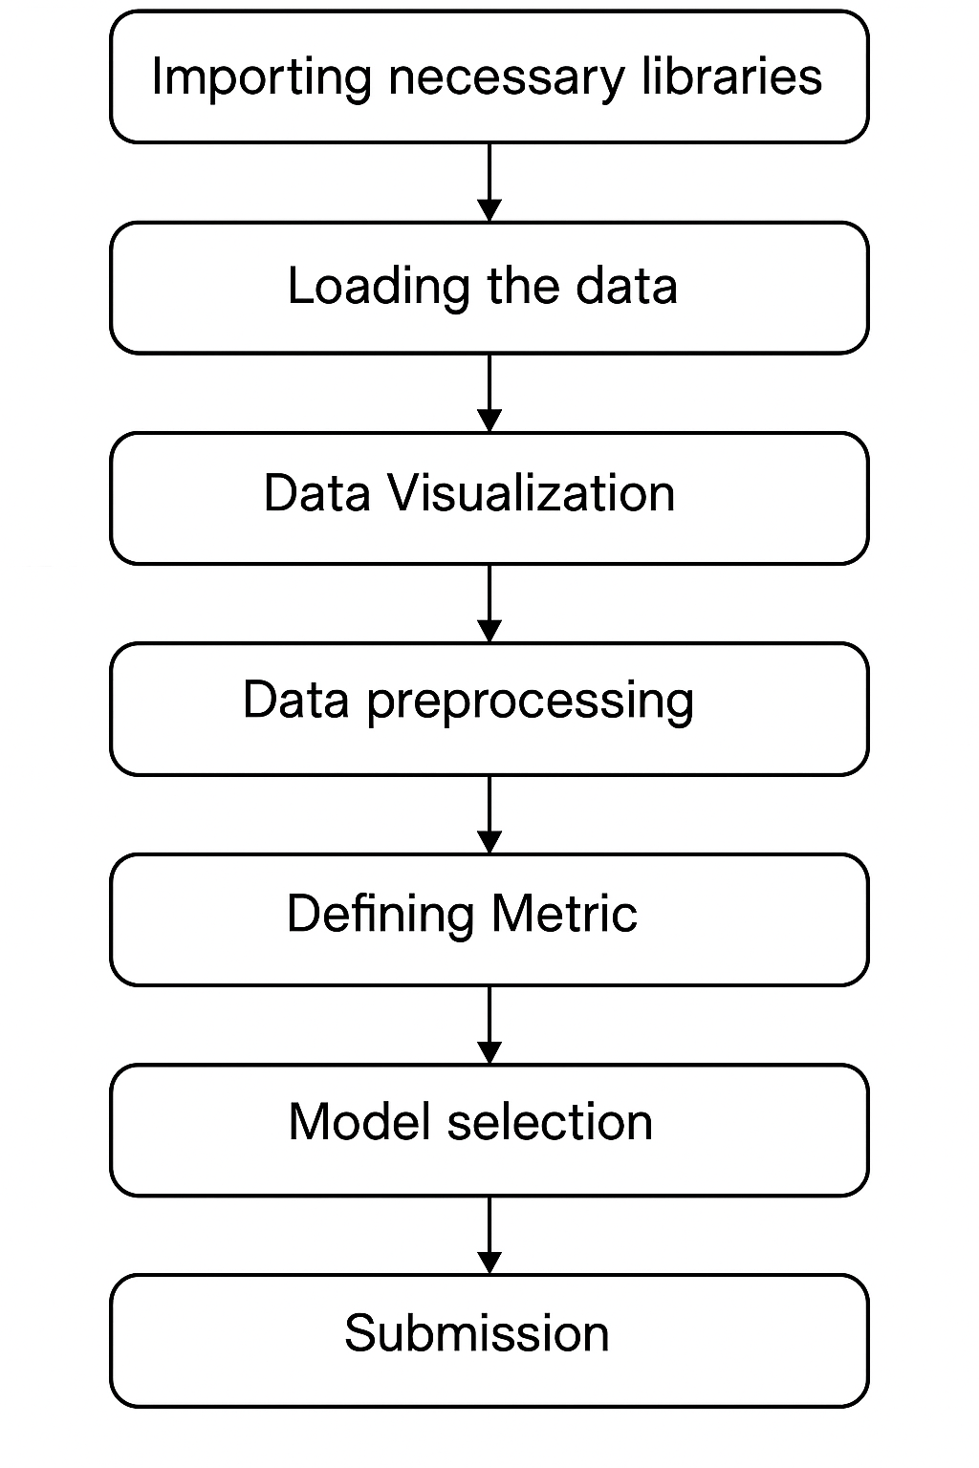
Step 2 - Data Collection and Loading
Collect relevant datasets, including historical bike usage, weather, and calendar data.
Load the datasets into environment variables using pandas' read_csv or similar functions.
Verify data integrity and handle missing values to ensure quality input for modeling.
Notes:
Image source: https://www.slidemake.com

Slide 5
Step 3 - Exploratory Data Analysis (EDA)
Conduct EDA to understand data distributions, trends, and relationships among variables.
Use visualization tools to identify patterns, outliers, and correlations.
EDA informs feature engineering and helps in selecting the most impactful predictors.
Notes:
Image source: https://images.singletracks.com

Slide 6

Step 4 - Data Preprocessing
Convert categorical variables into numerical formats using encoding techniques like one-hot encoding.
Normalize or scale features to improve model performance and convergence.
Split the dataset into training and testing sets to evaluate model effectiveness.
Notes:
Image source: https://images.singletracks.com

Slide 7
Step 5 - Feature Engineering
Create new features such as time-based variables, weather indicators, or holiday flags.
Select relevant features that have the highest predictive power for demand.
Reduce dimensionality if necessary to simplify the model and improve efficiency.
Notes:
Image source: https://images.singletracks.com

Slide 8
Step 6 - Model Selection and Training
Choose suitable machine learning algorithms like Random Forest, Gradient Boosting, or Neural Networks.
Train the models on the training dataset, tuning hyperparameters for optimal performance.
Validate models using cross-validation techniques to prevent overfitting.
Notes:
Image source: https://images.singletracks.com

Slide 9
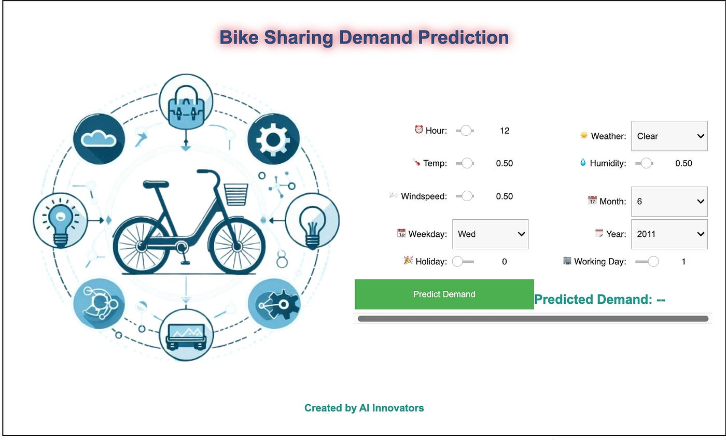
Step 7 - Model Evaluation and Deployment
Evaluate model performance using metrics such as RMSE, MAE, or R-squared.
Fine-tune the model based on evaluation results to improve accuracy.
Deploy the best model into production for real-time or batch demand prediction.
Notes:
Image source: https://images.singletracks.com

Slide 10
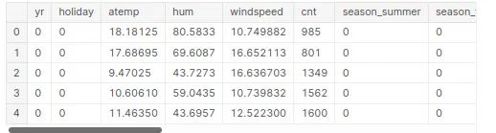
Conclusion and Future Directions
Machine learning can significantly enhance bike sharing demand prediction capabilities.
Incorporating real-time data and advanced models can further improve accuracy.
Continuous monitoring and model updating are essential for adapting to changing urban dynamics.
Notes:
Image source: https://images.singletracks.com

